Slide 1
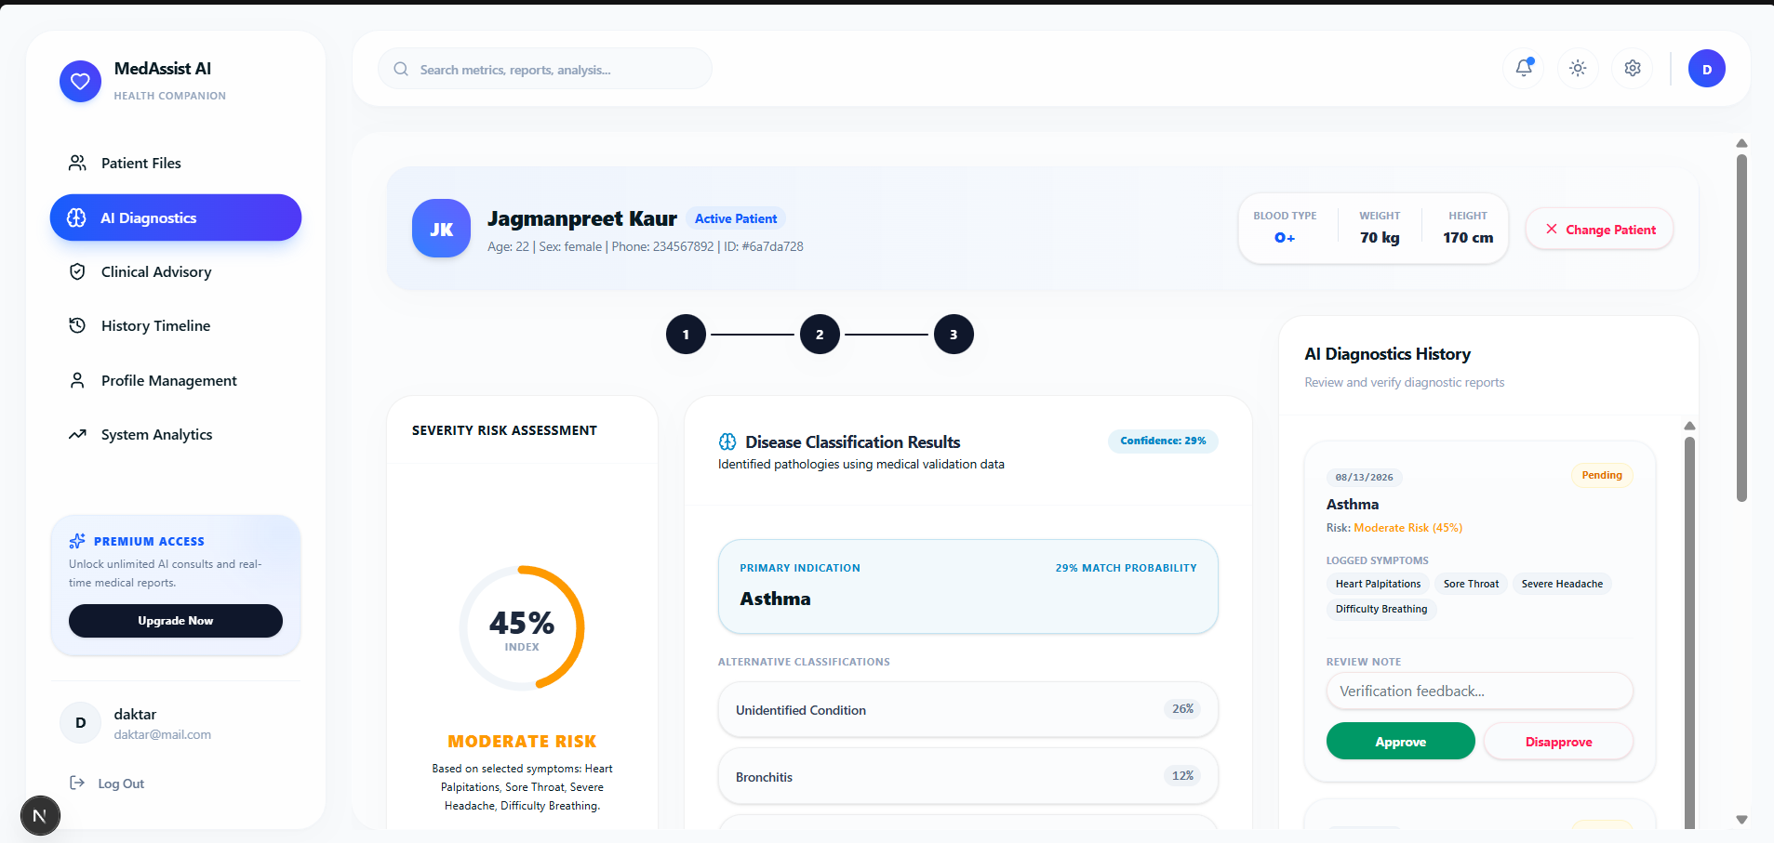
MEDASSIST AI
01 / 06
AI-assisted healthcare decision support
A single workflow connecting patient symptoms, AI predictions, severity assessment, reporting, and clinical review.
SYSTEM AT A GLANCE
Turn patient information into structured, reviewable clinical insights.
• Symptom-based disease classification
• Severity risk assessment
• Diagnostic history and reporting
• Doctor-side review and verification
• Persistent patient / doctor records
01
02
03
Patient data
AI analysis
Clinical review

Slide 2
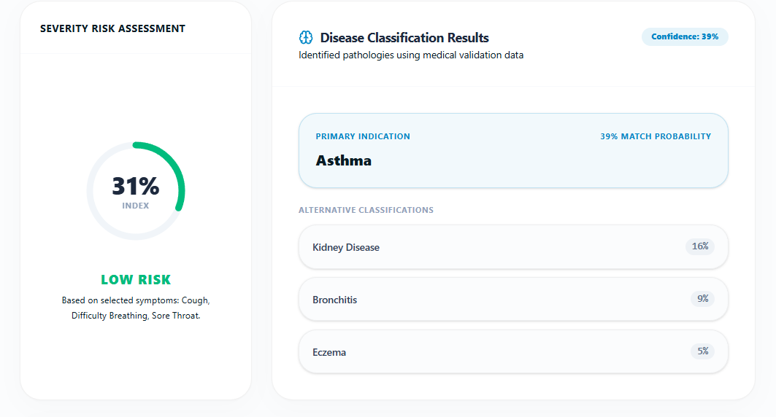
01 • ANALYSIS
02 / 06
AI symptom analysis → disease classification
The system evaluates patient information and presents a primary classification with alternatives and probabilities.
INPUT
• Patient demographics
• Symptoms
• Medical attributes
• Duration / factors
MODEL OUTPUT
Primary condition
Alternative classifications
Confidence / probability
The interface makes the prediction hierarchy visible rather than presenting a single opaque answer.

Slide 3
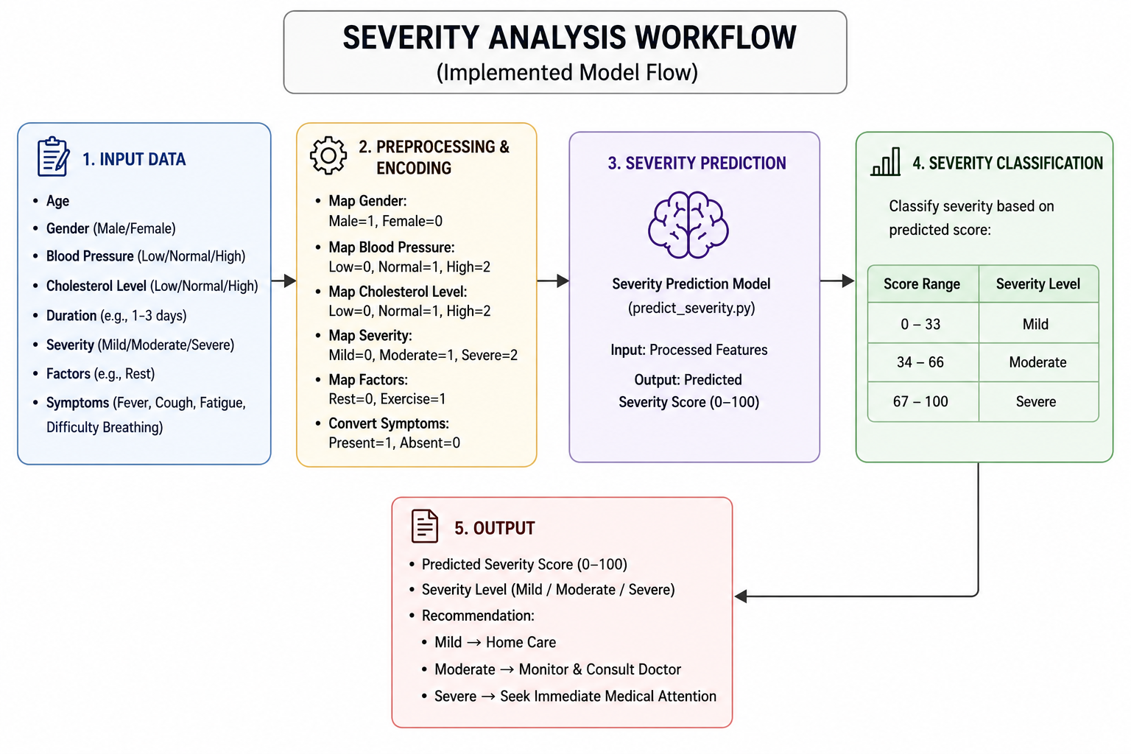
02 • RISK ENGINE
03 / 06
Severity analysis workflow
Implemented pipeline: encoded patient features → predicted severity score → severity band → recommendation.
CLASSIFICATION
0–33
Mild
34–66
Moderate
67–100
Severe
ENCODING
• Gender
• Blood pressure
• Cholesterol
• Severity / factors
• Symptom presence

Slide 4
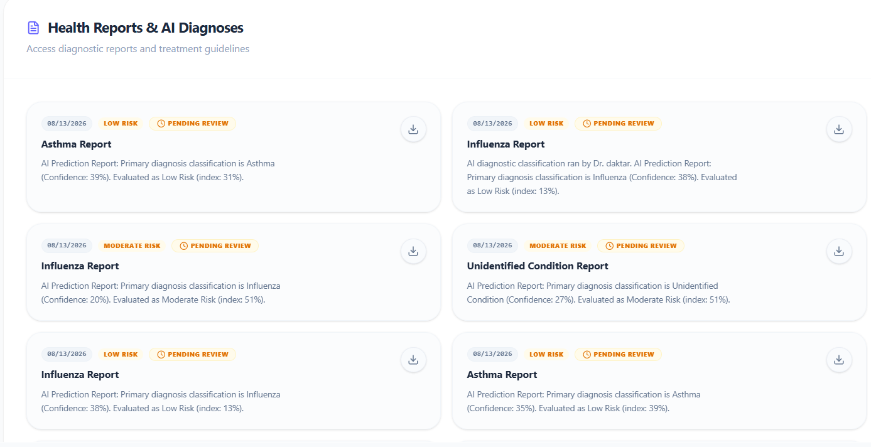
03 • REPORTING
04 / 06
From prediction to reviewable diagnostic records
Diagnostic reports expose the prediction, confidence, risk index, and review state in a doctor-facing workflow.
WHAT THE REPORT SURFACES
01
Diagnosis
Primary AI classification
02
Confidence
Prediction confidence
03
Risk
Risk level + index
04
Review
Pending / verified status
05
Record
Downloadable report

Slide 5
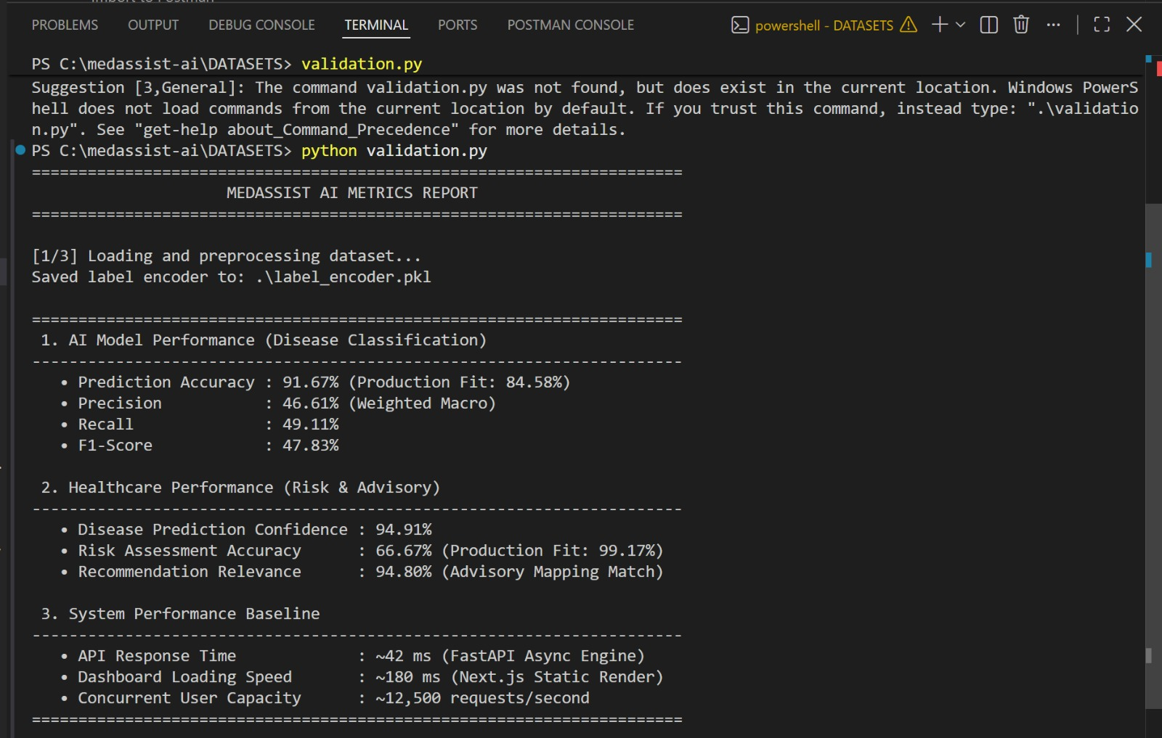
04 • VALIDATION
05 / 06
Model validation & system performance
Measured results are grouped by what they evaluate: classification, healthcare/advisory outputs, and runtime performance.
DISEASE CLASSIFICATION
91.67%
46.61%
49.11%
Prediction accuracy
Precision
Recall
F1-score 47.83% • Production Fit 84.58%
HEALTHCARE PERFORMANCE
94.91%
66.67%
Disease prediction confidence
Risk assessment accuracy
Production Fit 99.17% • Recommendation Relevance 94.80%
SYSTEM PERFORMANCE
~42 ms
~180 ms
~12,500
API response time
Dashboard loading
Requests / second

Slide 6
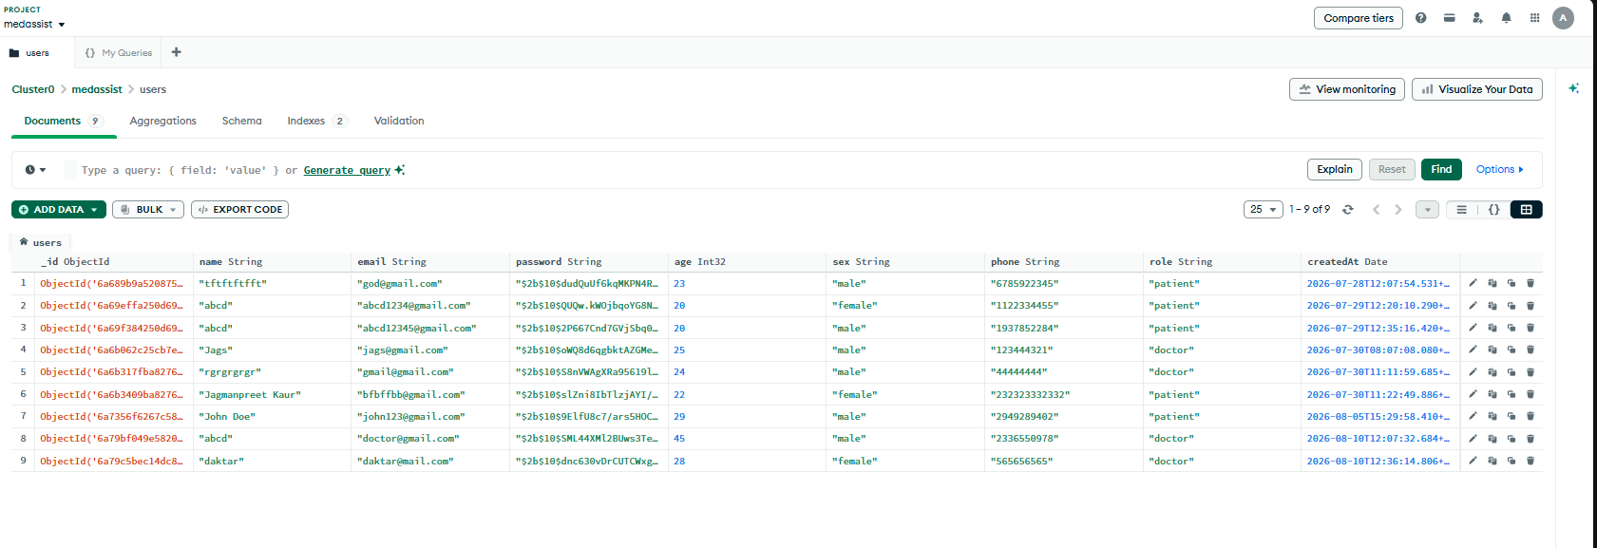
05 • DATA LAYER
06 / 06
Data management & backend integration
The demonstrated database stores structured patient and doctor account information alongside timestamps and roles.
VISIBLE RECORD FIELDS
_id
name
email
password
age
sex
phone
role
createdAt
APPLICATION DATA FLOW
Frontend
→
Backend / API
→
Database
→
Stored patient / doctor data

